Slide 1

Animation Story Pitch
By Marco Chu

Slide 2
Idea 1 ZA WURLDO
Story
Person Leaning on chair
About to fall
Time stop
Deity Character walks in(sighs), balances character
Character falls back into original position
Animation should loop

Slide 3
Idea 1
Animation Principles
Stretch and Squash(Stretch when almost falling, squash when falling back)
Exaggeration(In a position that should already have the character fall)
Follow Through (Arms, hair)
Slow In Slow Out(The rocking of the chair)

Slide 4
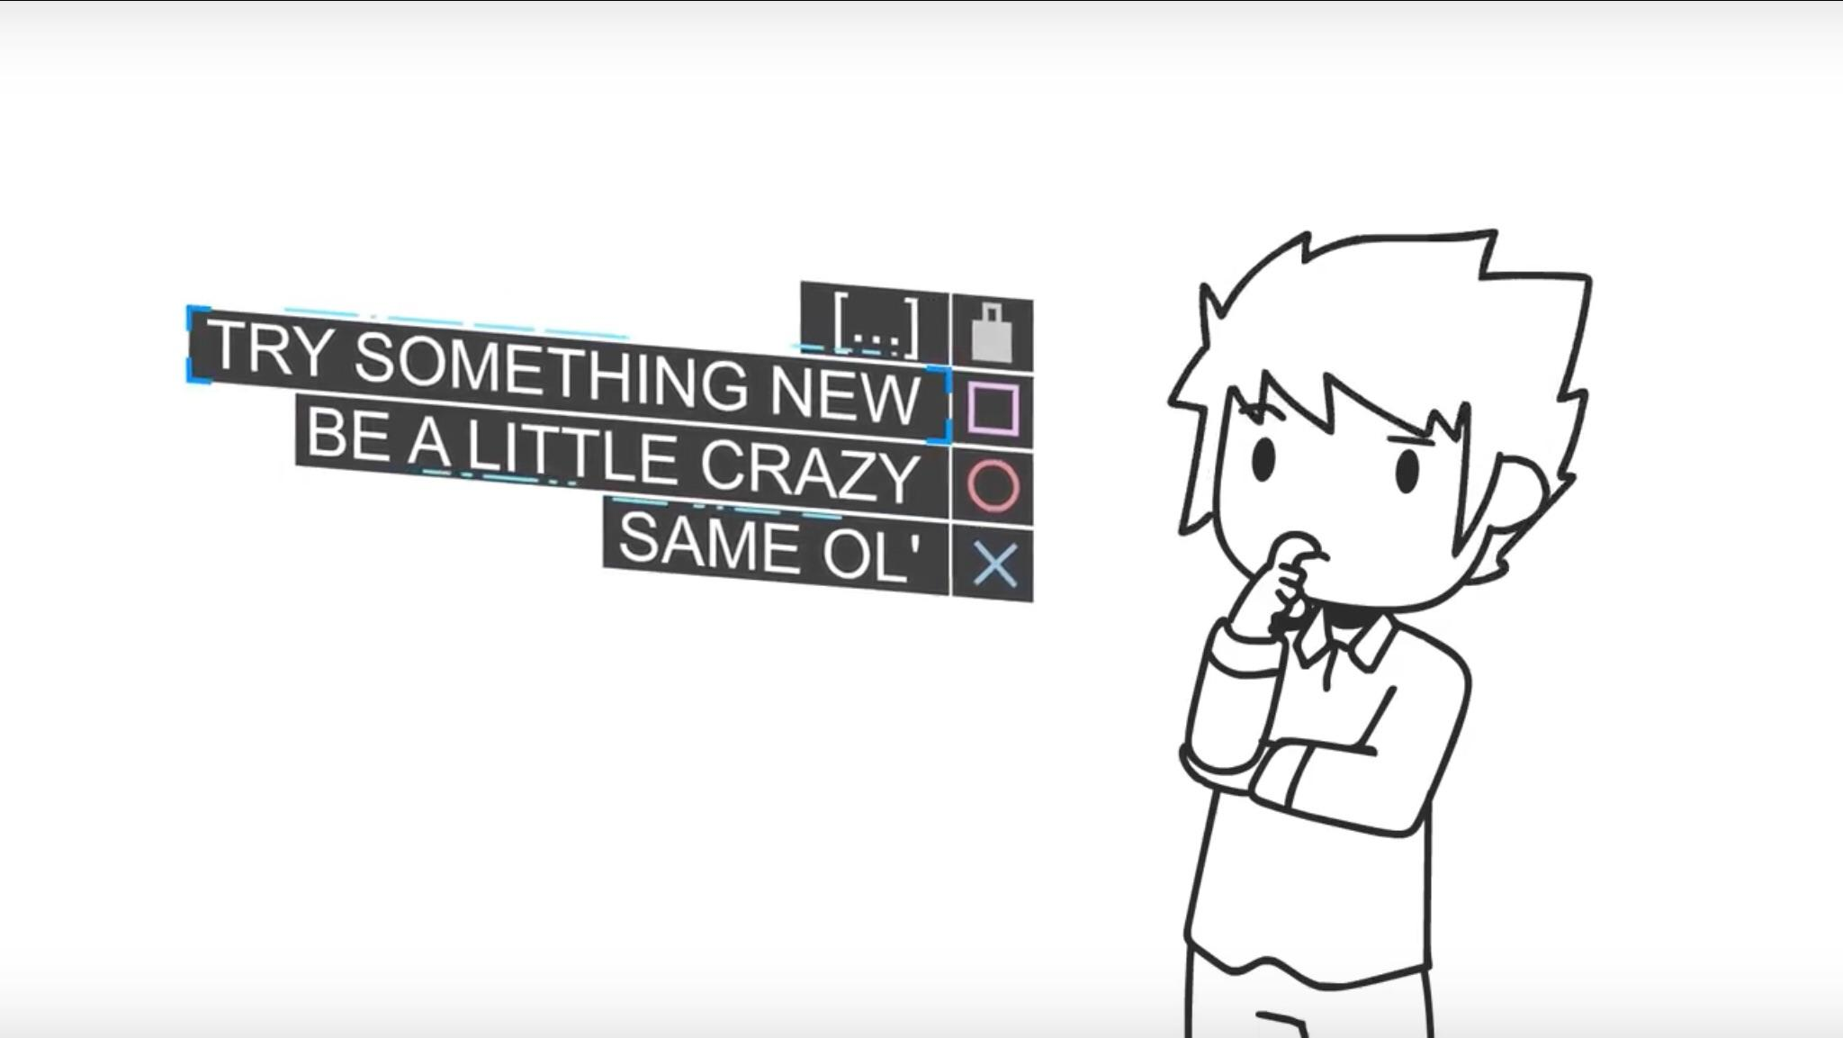
Idea 1
Art Style
Web Comic
Domics

Slide 5
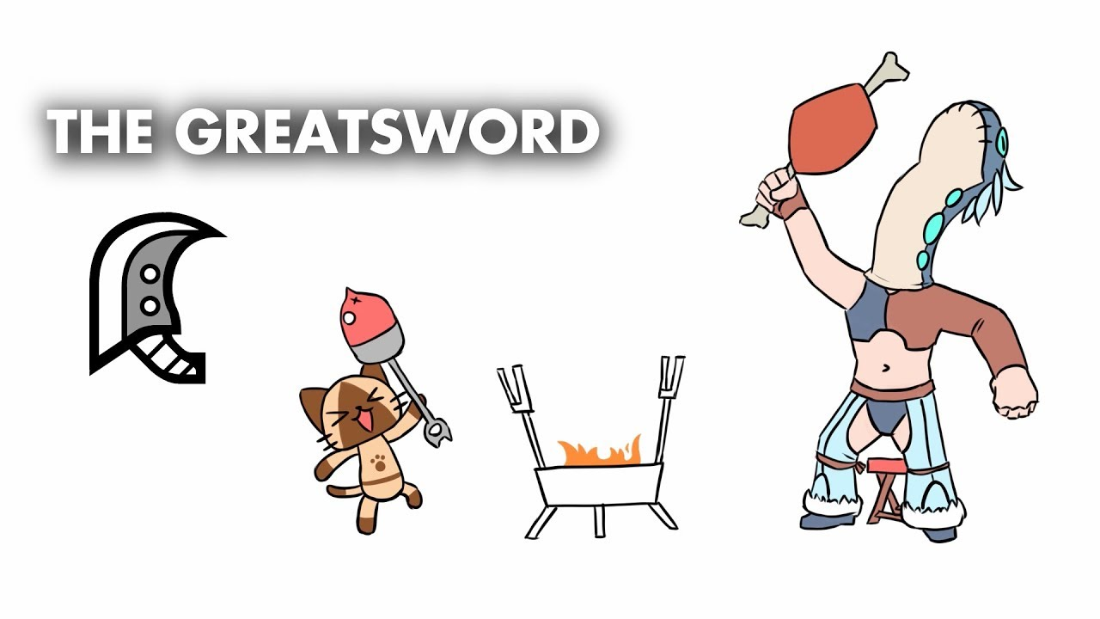
Idea 2 Great Sword Users
Story
Character pulls sword out of ground
Character swinging a sword
Is thrown around by the momentum
Slices world in half (Zoom out to see world)

Slide 6
Idea2
Animation Principle
Anticipation
Follow Through (Sword, character being pulled forward)
Slow In Slow out
Stretch(arms, body)

Slide 7
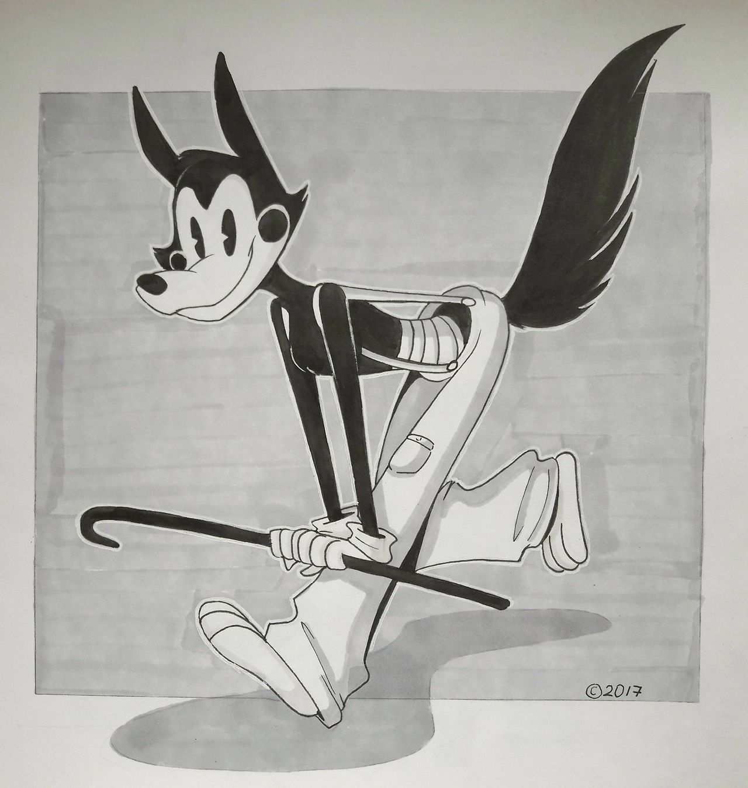
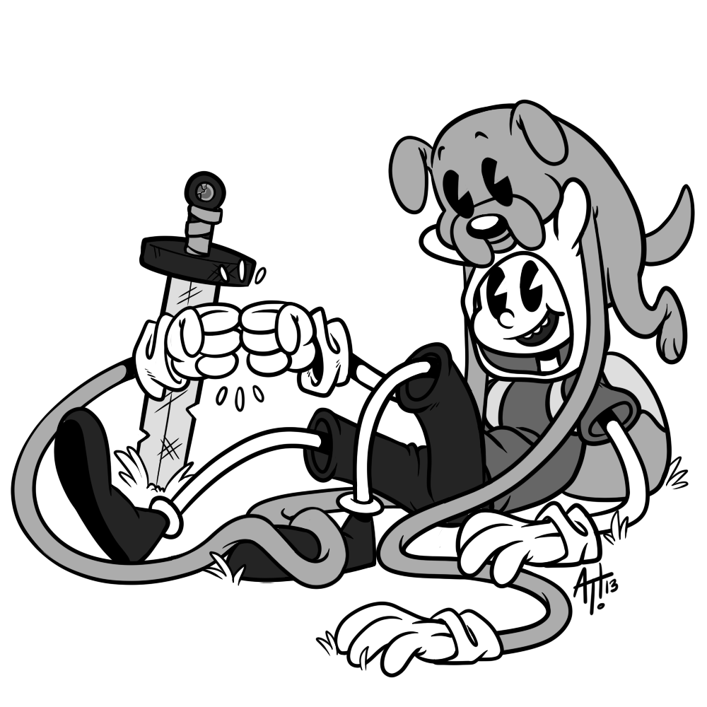
Idea 2
Art Style
Old Disney
Stretchy Limbs/ Body

Slide 8
Idea 3 Stuffed Animal
Story
Stuffed animal with balloon tied to it, hanging on rail
Balloon begins to pull animal up
Stretches on rail until the rail comes out
Pipes burst, bear floats away with rail

Slide 9
Idea 3
Animation Principles
Staging characters facial expression
Stretch and Squash when character gets pulled and pulls back down
Exaggeration

Slide 10
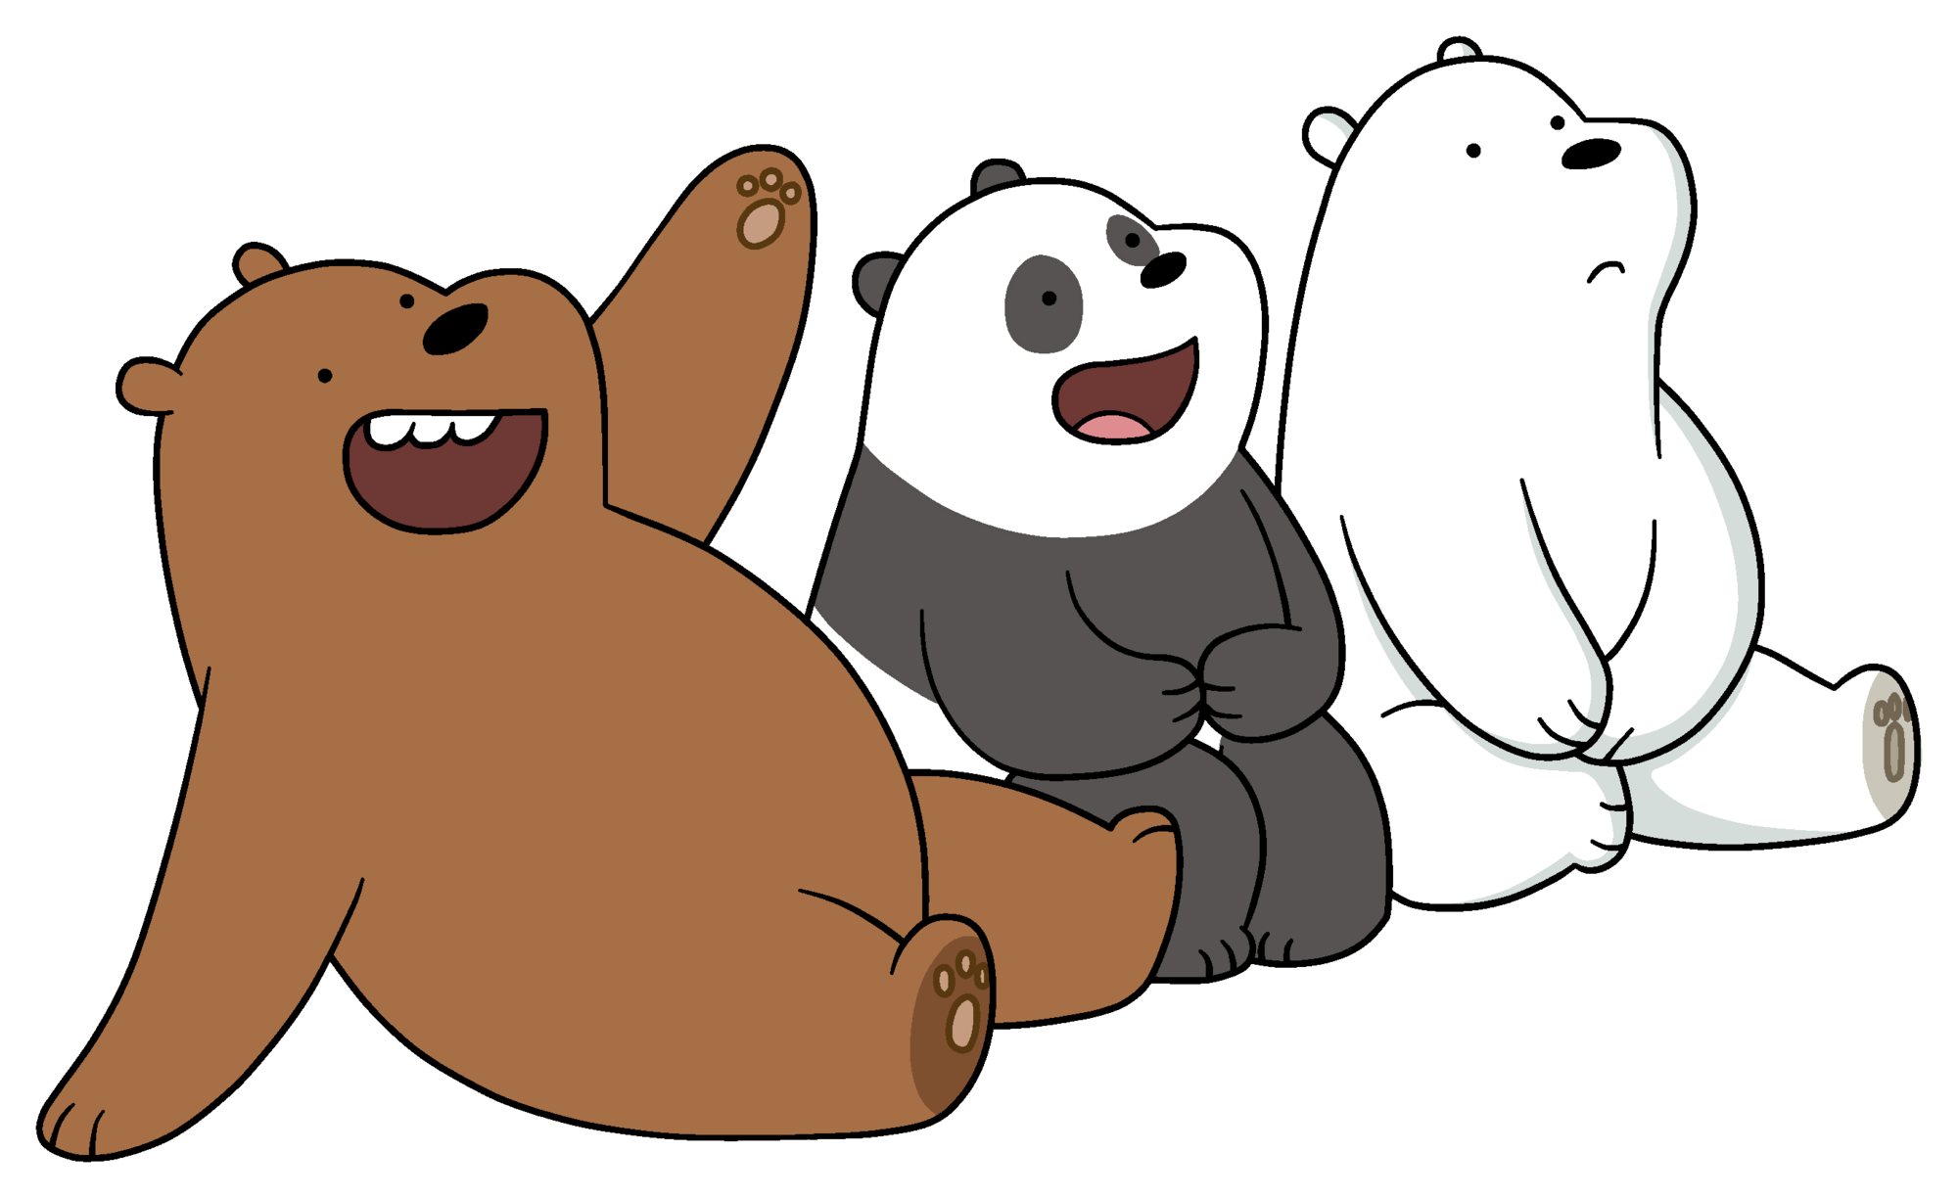
Idea 3
Art Style
We Bare Bears
Minimalistic

